Slide 1
THERE IS NO "AWAY"
Waking up to Consumption and waste

Slide 2
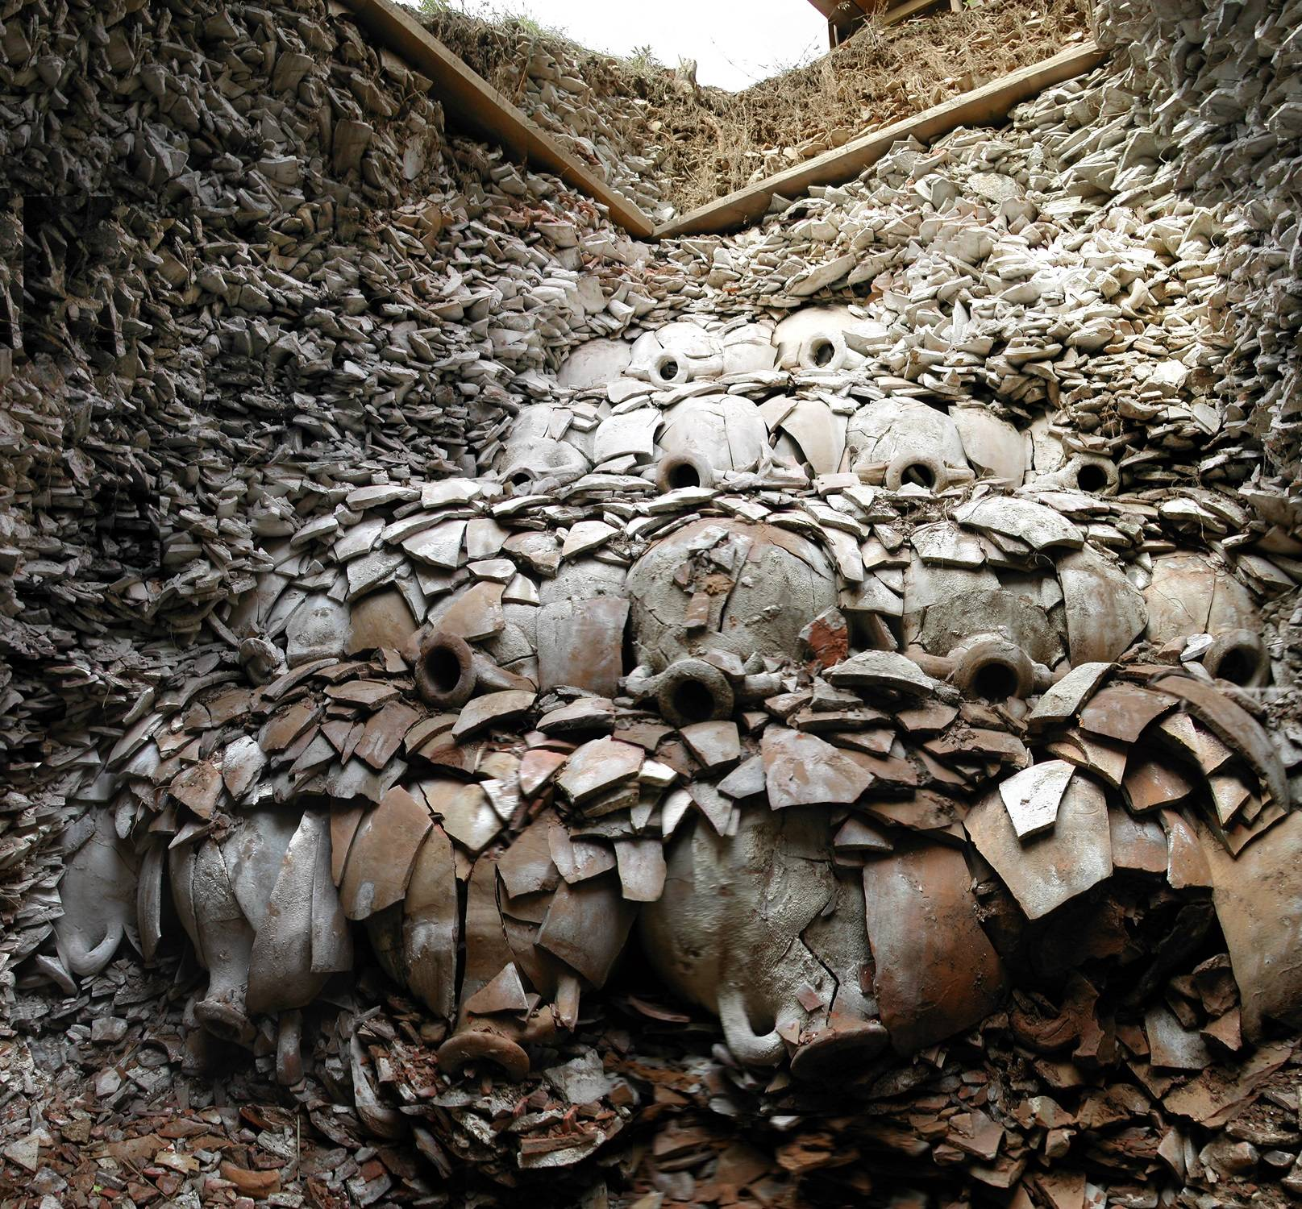
We've always had waste…

Slide 3
The Industrial Revolution led to disposable goods

Slide 5
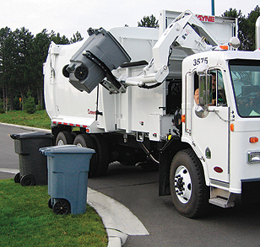
Our awareness ends at the curb.

Slide 6
"Do I use this? Not right now, but I saved it for a specific use…."
- Self-acknowledged hoarder and blogger Melinda LeFevers

Slide 7
35 ton pile of trash:
Amount of trash produced in the average lifetime: 102 tons

Slide 8
How much trash?
Globally: 2 billion tons/year
Nationally: 390 million tons/year
Average person: 102 tons/year
- BioCycle State of Garbage in America

Slide 9
Puente Hills in Los Angeles County: 700 acres, rising 500 feet above surrounding areas

Slide 10
Where is our garbage going?

Slide 11
Otter Tail County
→ 31,000 tons MSW annually (Municipal Solid Waste = garbage)
→ 21,000 tons goes to a Waste-to-Energy Facility in Perham
→ 4,500 tons recycling sorted and sold to end-markets
→ 12-17% Residential Recycling Rate (ESTIMATED!)
Does not include special waste programs such as scrap metal, electronics, hazardous items, etc.

Slide 12
Your trash is a resource…
NATURAL RESOURCES!

Slide 13
15 million barrels of oil → plastic bottles each year

Slide 14
15 billion trees cut annually

Slide 15
Mining bauxite ore for aluminum

Slide 16
Sand Mining

Slide 17
40% of food produced is wasted

Slide 18
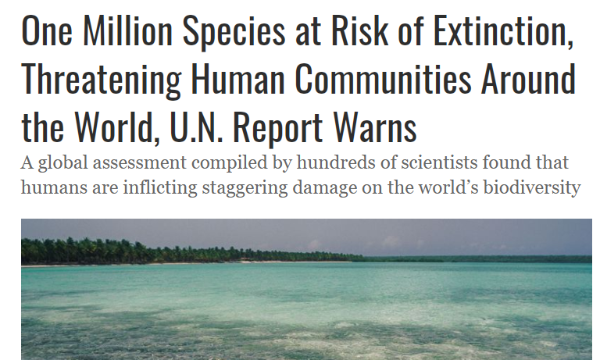

Slide 19
Rivers of trash…
Citarum River in Indonesia, used as a trash and sewage disposal system

Slide 20
Islands are magnets for for plastic pollution

Slide 21
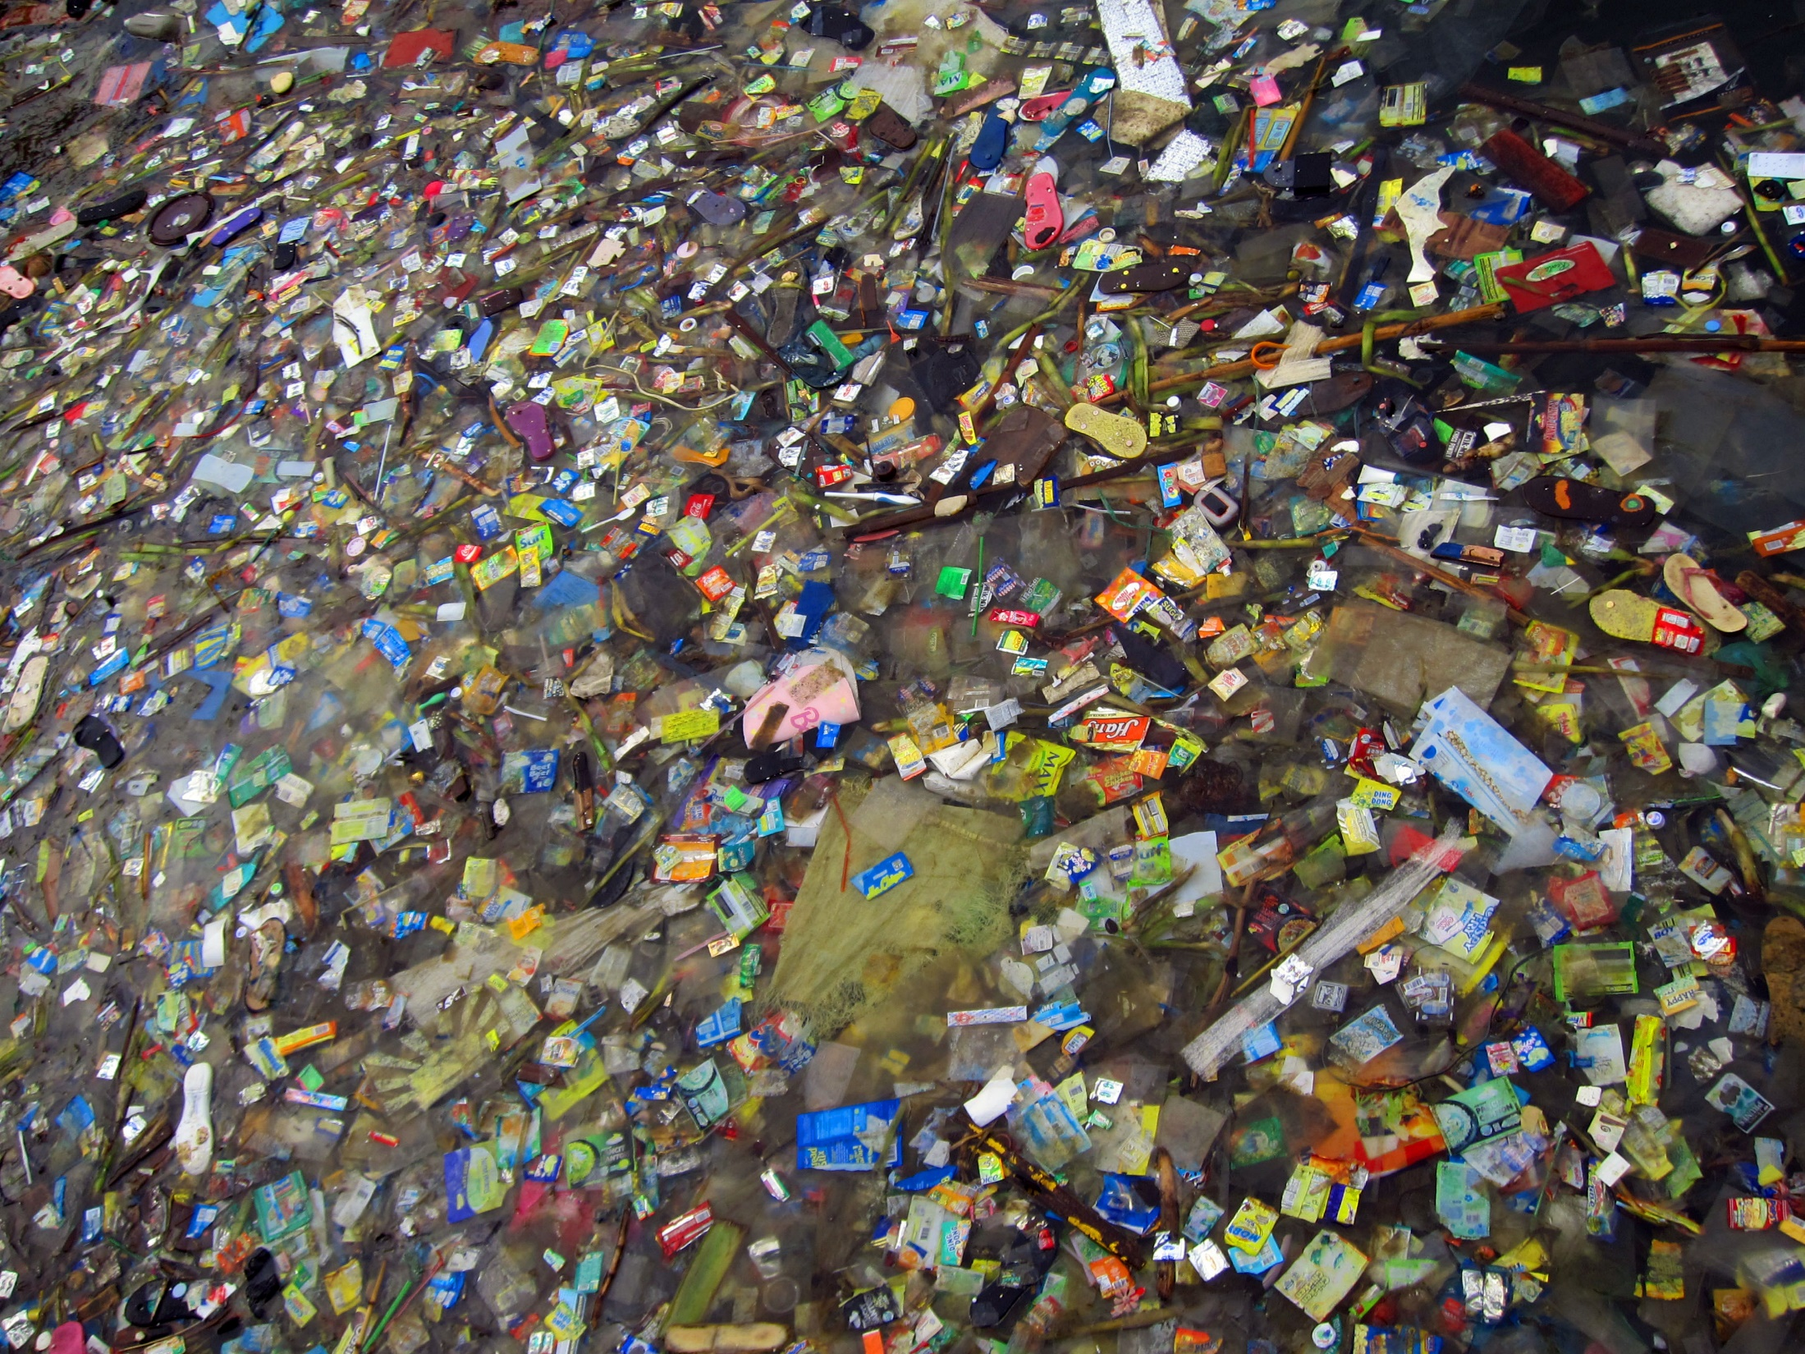

Slide 22
Annie Leonard: The Story of Stuff

Slide 23
Consumers Zombie Wake Up Call: photograph by Radoslav Nedelchev

Slide 24
Manufactured Demand

Slide 25
Manufactured Demand

Slide 26
We buy twice as many clothes and keep them half as long as we did 20 years ago.

Slide 27
3.8 billion lbs of textile waste goes to landfills every year in the U.S.

Slide 29
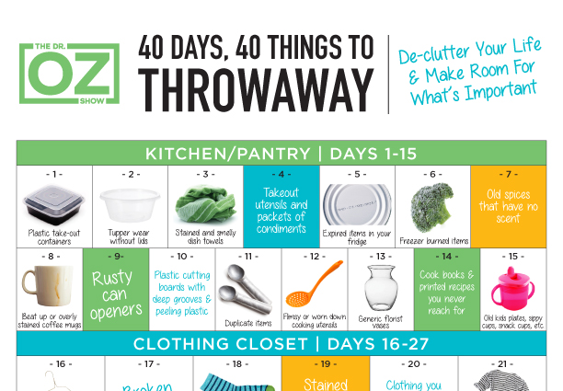

Slide 30
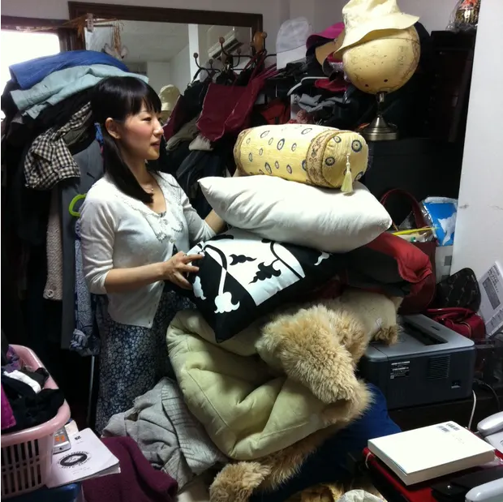
Bogged down by material wealth
Famous tidying and organizational expert Marie Kondo

Slide 31
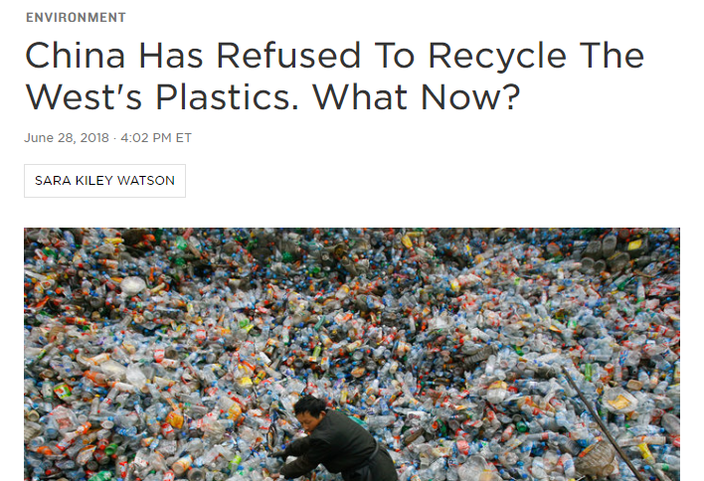
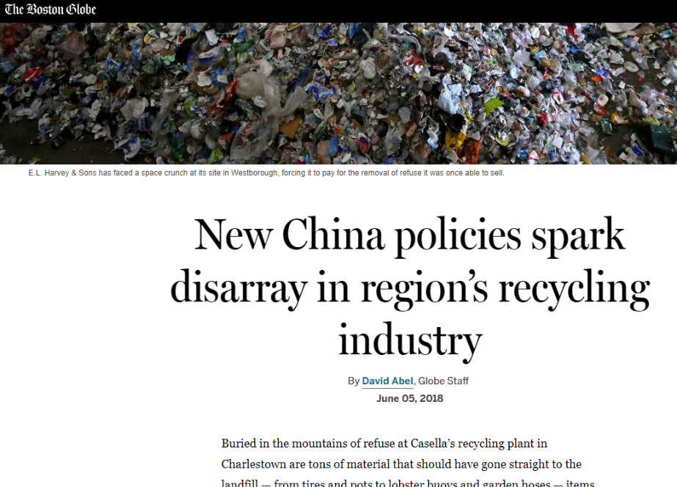
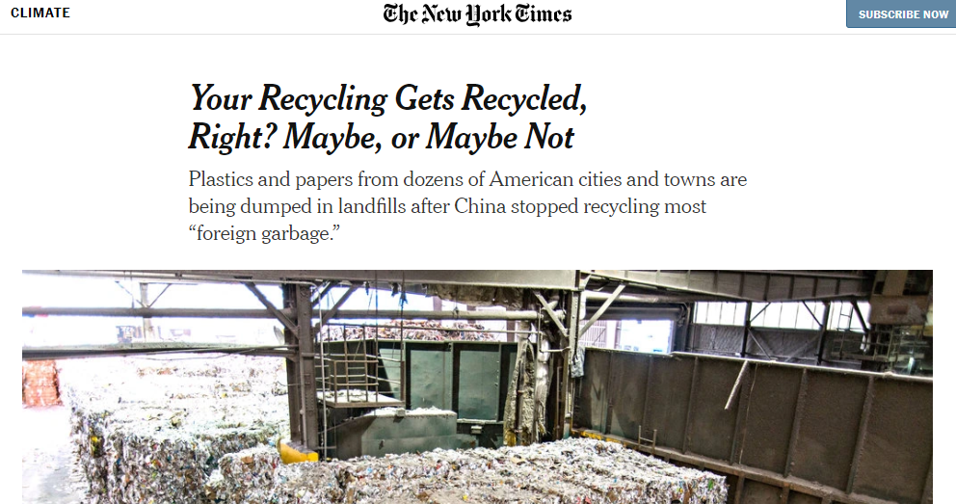

Slide 33
Zero-Waste Trash Jar

Slide 34
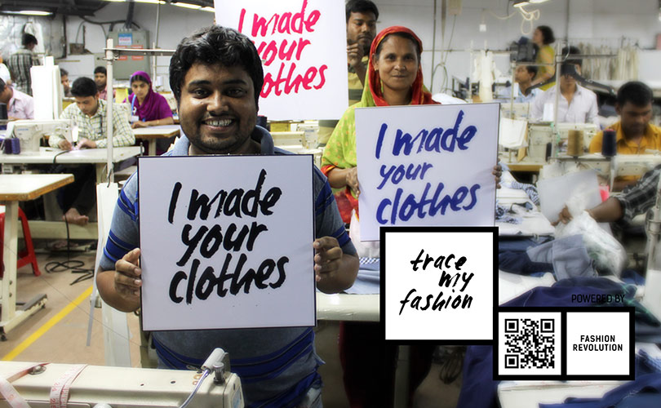

Slide 37
Thrift store uptick

Slide 38
Satish Kumar
"Our lack of simplicity causes climate change, loss of biodiversity and pollutes our oceans."

Slide 39
What can you do?
Recycle
Invest in Reusable Items
Put the pressure on companies you buy from
Advocate for local ordinances that would reduce waste
Speak up!
Give experiences, not more stuff
Better, not more. Invest in items you will value and keep for longer
Cheap is not actually cheap, someone somewhere is paying
Don’t let advertising get the better of you

Slide 40
“The most remarkable feature of this historical moment on Earth is not that we are on the way to destroying the world — we've actually been on the way for quite a while. It is that we are beginning to wake up, as from a millennia-long sleep, to a whole new relationship to our world, to ourselves and each other.”
- Joanna Macy

